Slide 1


AI-Powered Sentiment Analysis in Media and Entertainment
AI is transforming media and entertainment. Sentiment analysis helps understand audience reactions. This study analyzes YouTube comments using NLP. It classifies comments as positive, negative, or neutral.
By-Amit Rajput

Slide 2

Understanding Audience Sentiment
1
AI & NLP
2
Sentiment
AI and NLP analyze vast amounts of text data.
Sentiment impacts content success and improvement.
3
Real-time Analysis
AI provides real-time user emotion analysis.

Slide 3
Methodology: Analyzing YouTube Comments
Data Preprocessing
TF-IDF Vectorization
Logistic Regression
URLs and non-alphabetic characters were removed.
Text was prepared using TF-IDF for machine learning.
Sentiment classification was done using Logistic Regression.

Slide 4
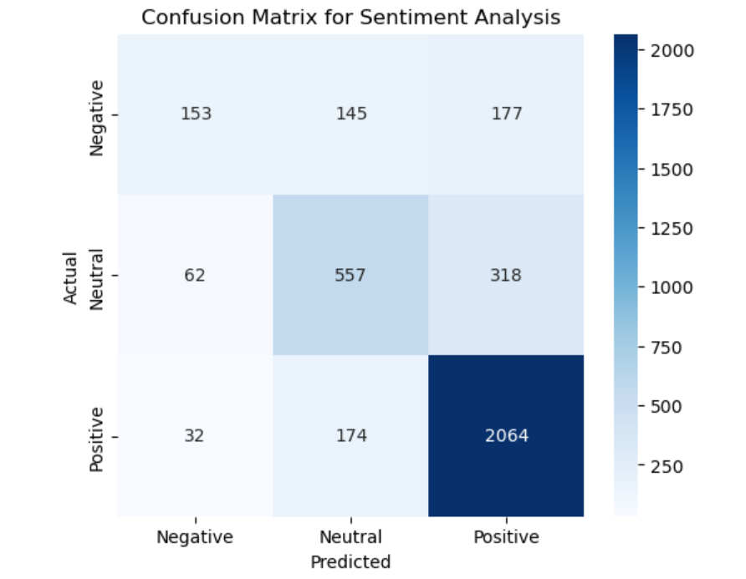
Key Findings: Sentiment Distribution
Positive
Neutral
Most frequent comments were positive.
Neutral comments followed positive ones.
Negative
Negative comments were the least frequent.

Slide 5
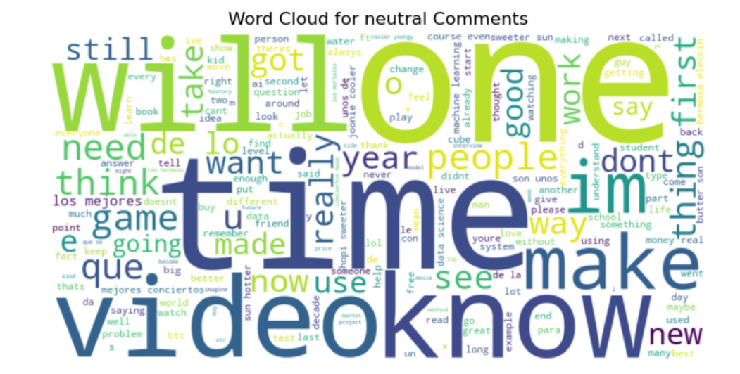
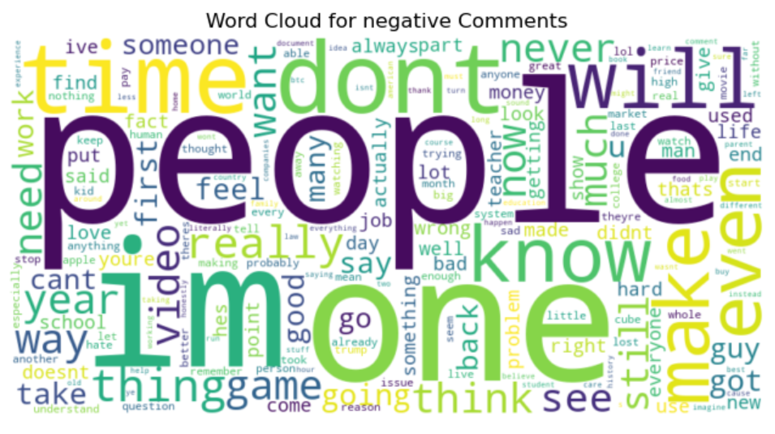



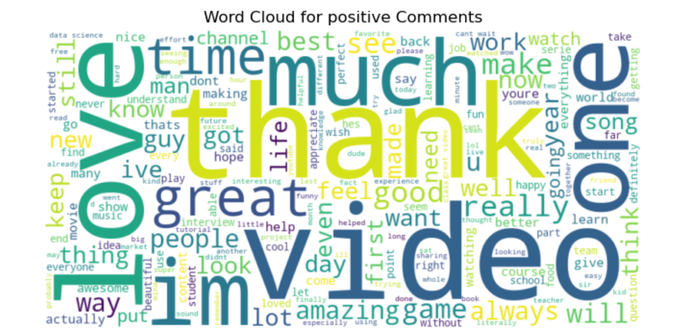
Word Clouds: Visualizing Sentiment
Positive Words
Negative Words
Neutral Words
"Love," "thank," and "great" were common.
"Problem," "money," and "bad" appeared often.
"Video," "time," and "game" were frequent.

Slide 6




Challenges and Limitations
Sarcasm
AI struggled with sarcasm and ambiguous language.
Context
Difficulty in understanding complex contexts.
Accuracy
Model achieved 76% accuracy after preprocessing.

Slide 7



AI's Impact on Media Operations
2
Content Moderation
1
Personalization
Audience Interaction
3
AI optimizes content and enhances audience interaction. It helps in personalizing recommendations.

Slide 8



Conclusion: Future of Sentiment Analysis
1
Deep Learning
2
Improved Accuracy
3
Better Engagement
Deep learning models can improve sentiment classification. AI will reshape organization-customer interaction.

Slide 9

Thank You!
Any Questions?

